Slide 1
Egnyte Overview
Name

Slide 2























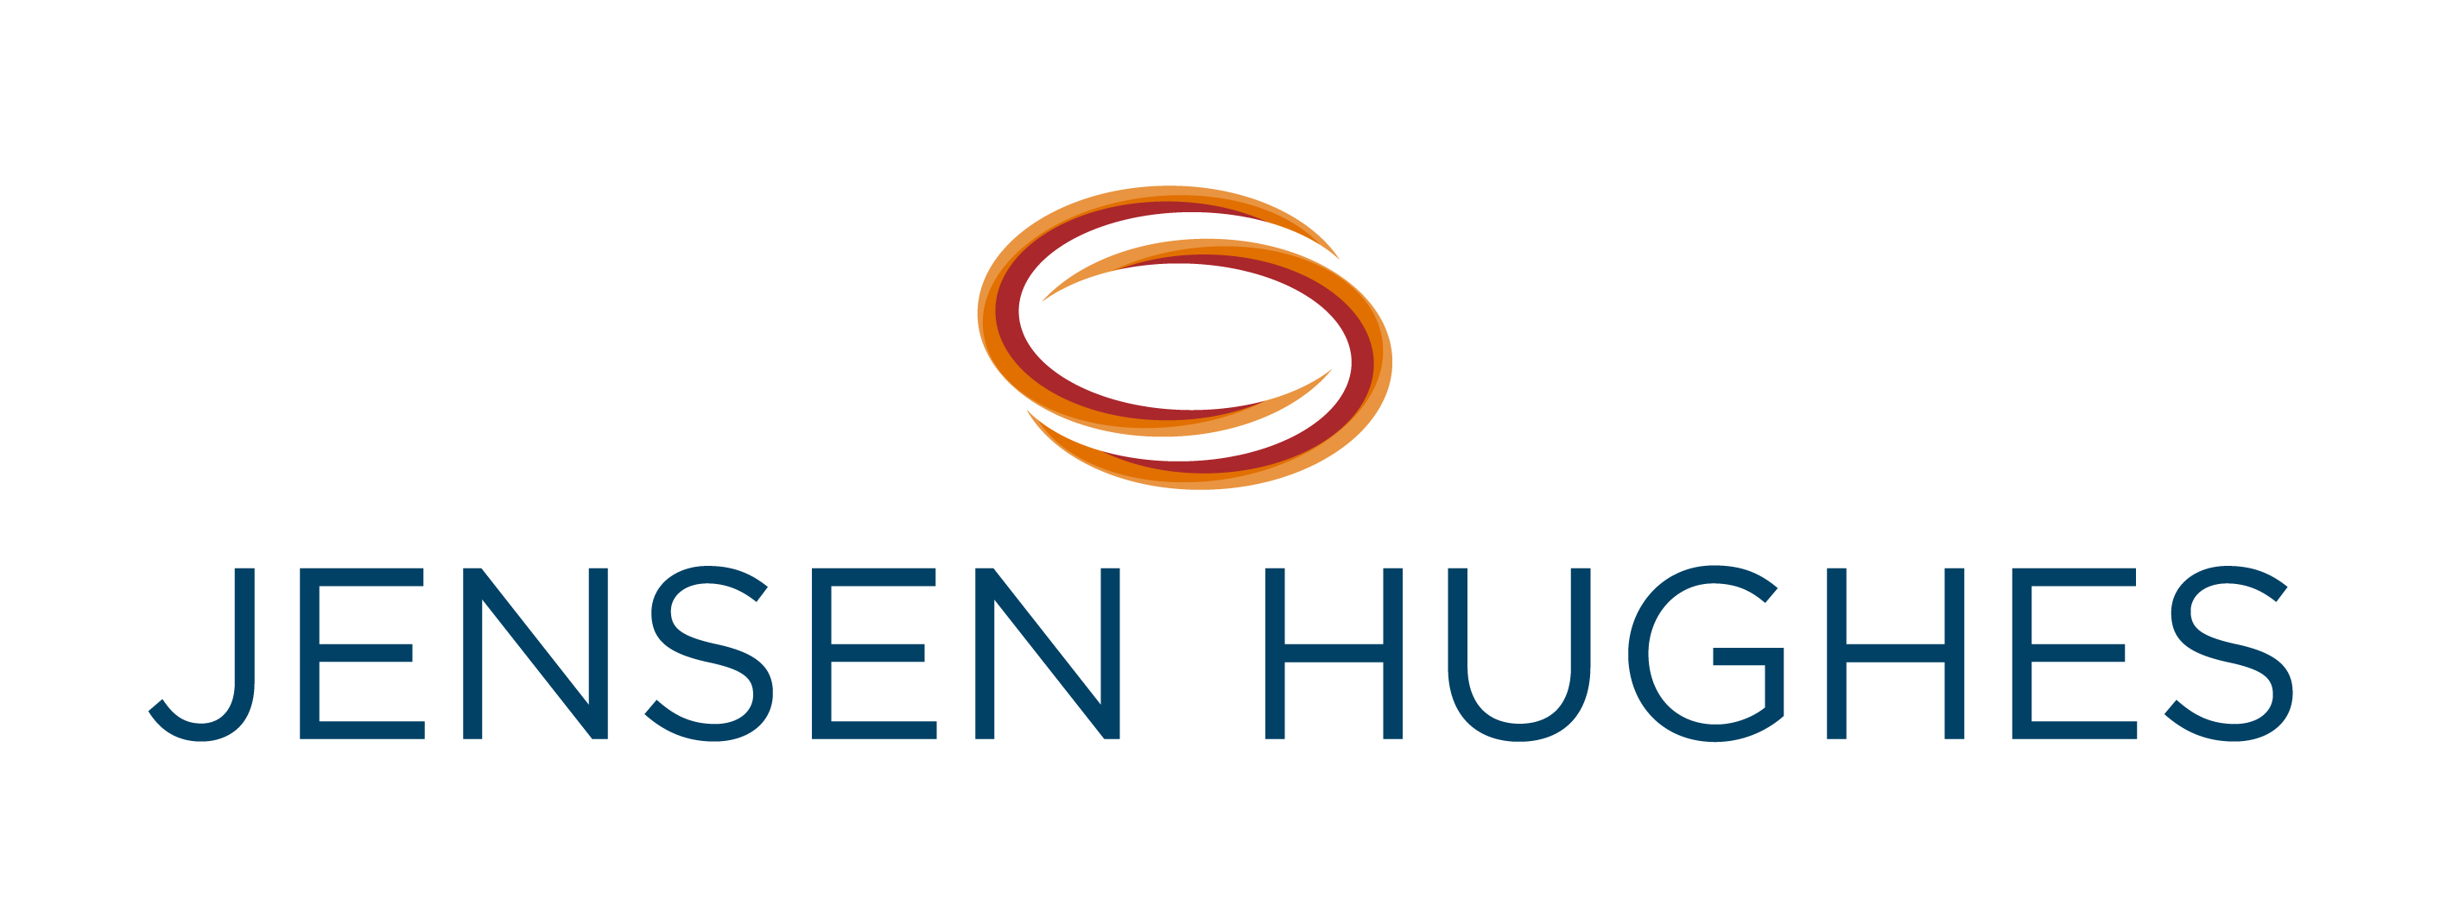
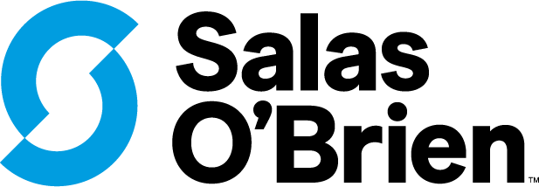























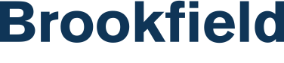




22,000+ Customers
WORLDWIDE
Architecture, Engineering, Construction, and Owners
Financial Services
Life Sciences
Media & Entertainment
Retail, Services, and Technology
MSPs and VARs

Slide 3





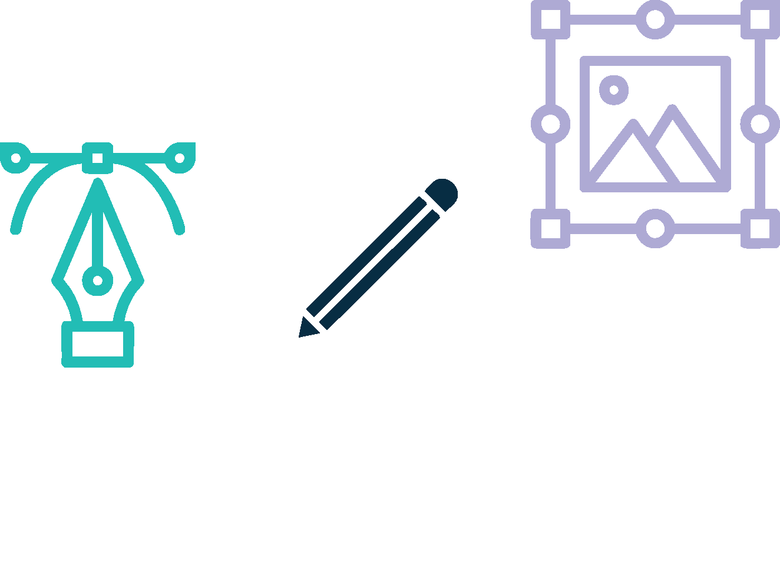

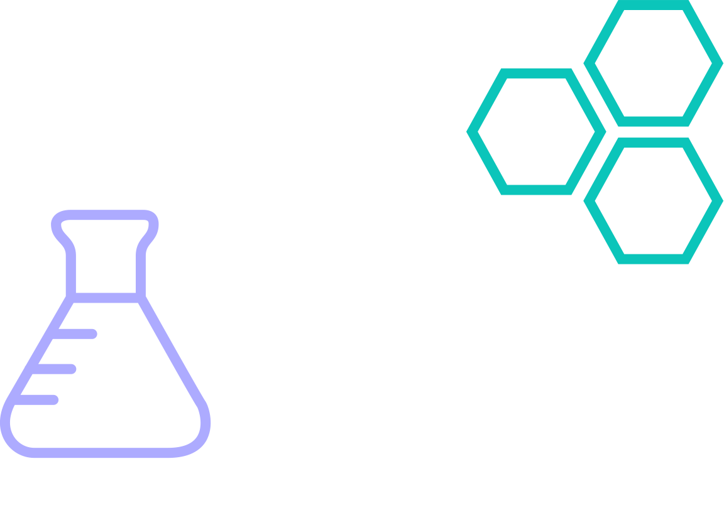

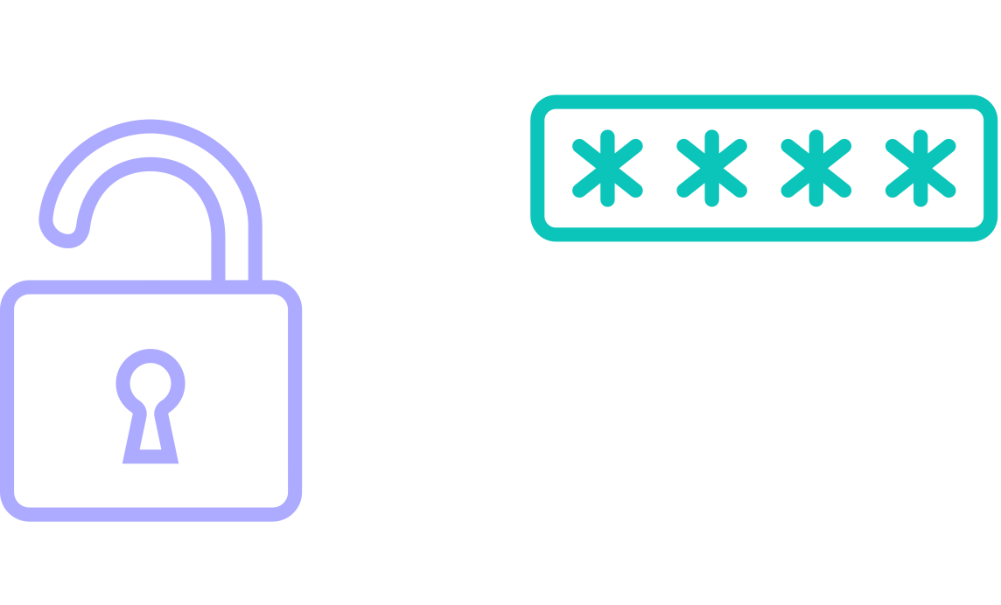
Content is Complex
Experiment Data
CAD and BIM files
Investment Memorandums
Case Files
Financial Models
MISSION-CRITICAL
Creative Designs
SOPs
4K Videos
R&D Data
Personnel Records

Slide 4
Mission-Critical Content Requires Industry Specific Considerations
WORKFLOWS
UNIQUE INSIGHTS
POLICIES AND REGULATIONS
Complex, interlinked files
Massive file sizes
Multi-party collaboration
Security imperative
Industry context and nuances
Complex content types
High-value content
Industry regulations
Privacy requirements

Slide 5



CONTENT CLOUD
FOR MISSION-CRITICAL CONTENT
COLLABORATION
INTELLIGENCE
GOVERNANCE
PLATFORM

Slide 6







Business-Centric Content Cloud
G
365
Adobe
CAD
UNIFIED REPOSITORY
Companies own their content, not their users. A shared repository avoids the use of private drives.
Our permissions inheritance comes with the flexibility to change them to share “in-place”.
FULL DESKTOP SUPPORT
Egnyte works just like a file server in the cloud; it can be accessed via a letter drive.
Users can collaborate from desktop applications (Excel, AutoCAD, InDesign, etc.).
G:\
Projects
Acadia
APPLICATION AWARENESS
Badlands
We certify applications from vendors such as Autodesk, Adobe, Esri, Bentley, and more.
Specialized application operations work in the cloud, e.g. linking, versioning, and locking.
Crater Lake
CENTRALIZED GOVERNANCE
Denali
Egnyte enables centralizing security, compliance, and governance policies across all repositories.
Connectors are available for cloud and on-prem storage: AWS S3, Wasabi, SharePoint, Dropbox, Box, etc.
Notes:
Architectural principles

Slide 7
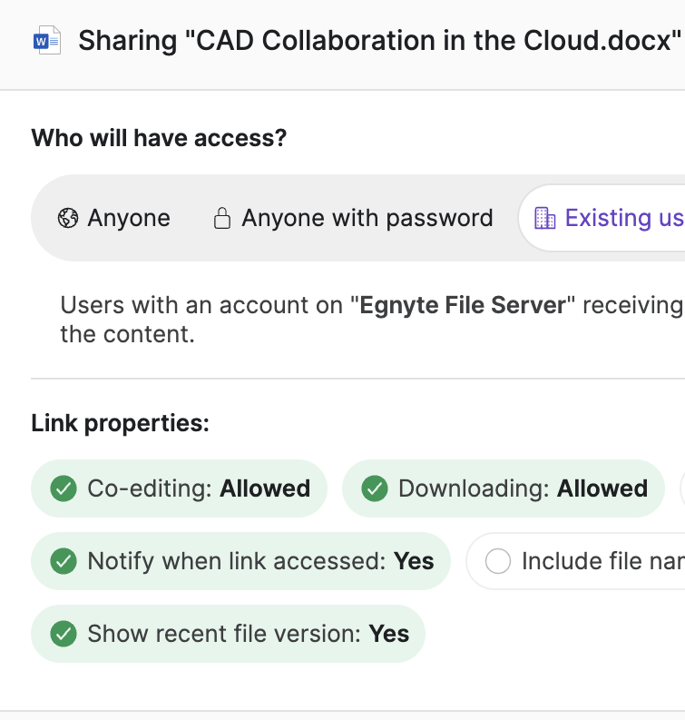
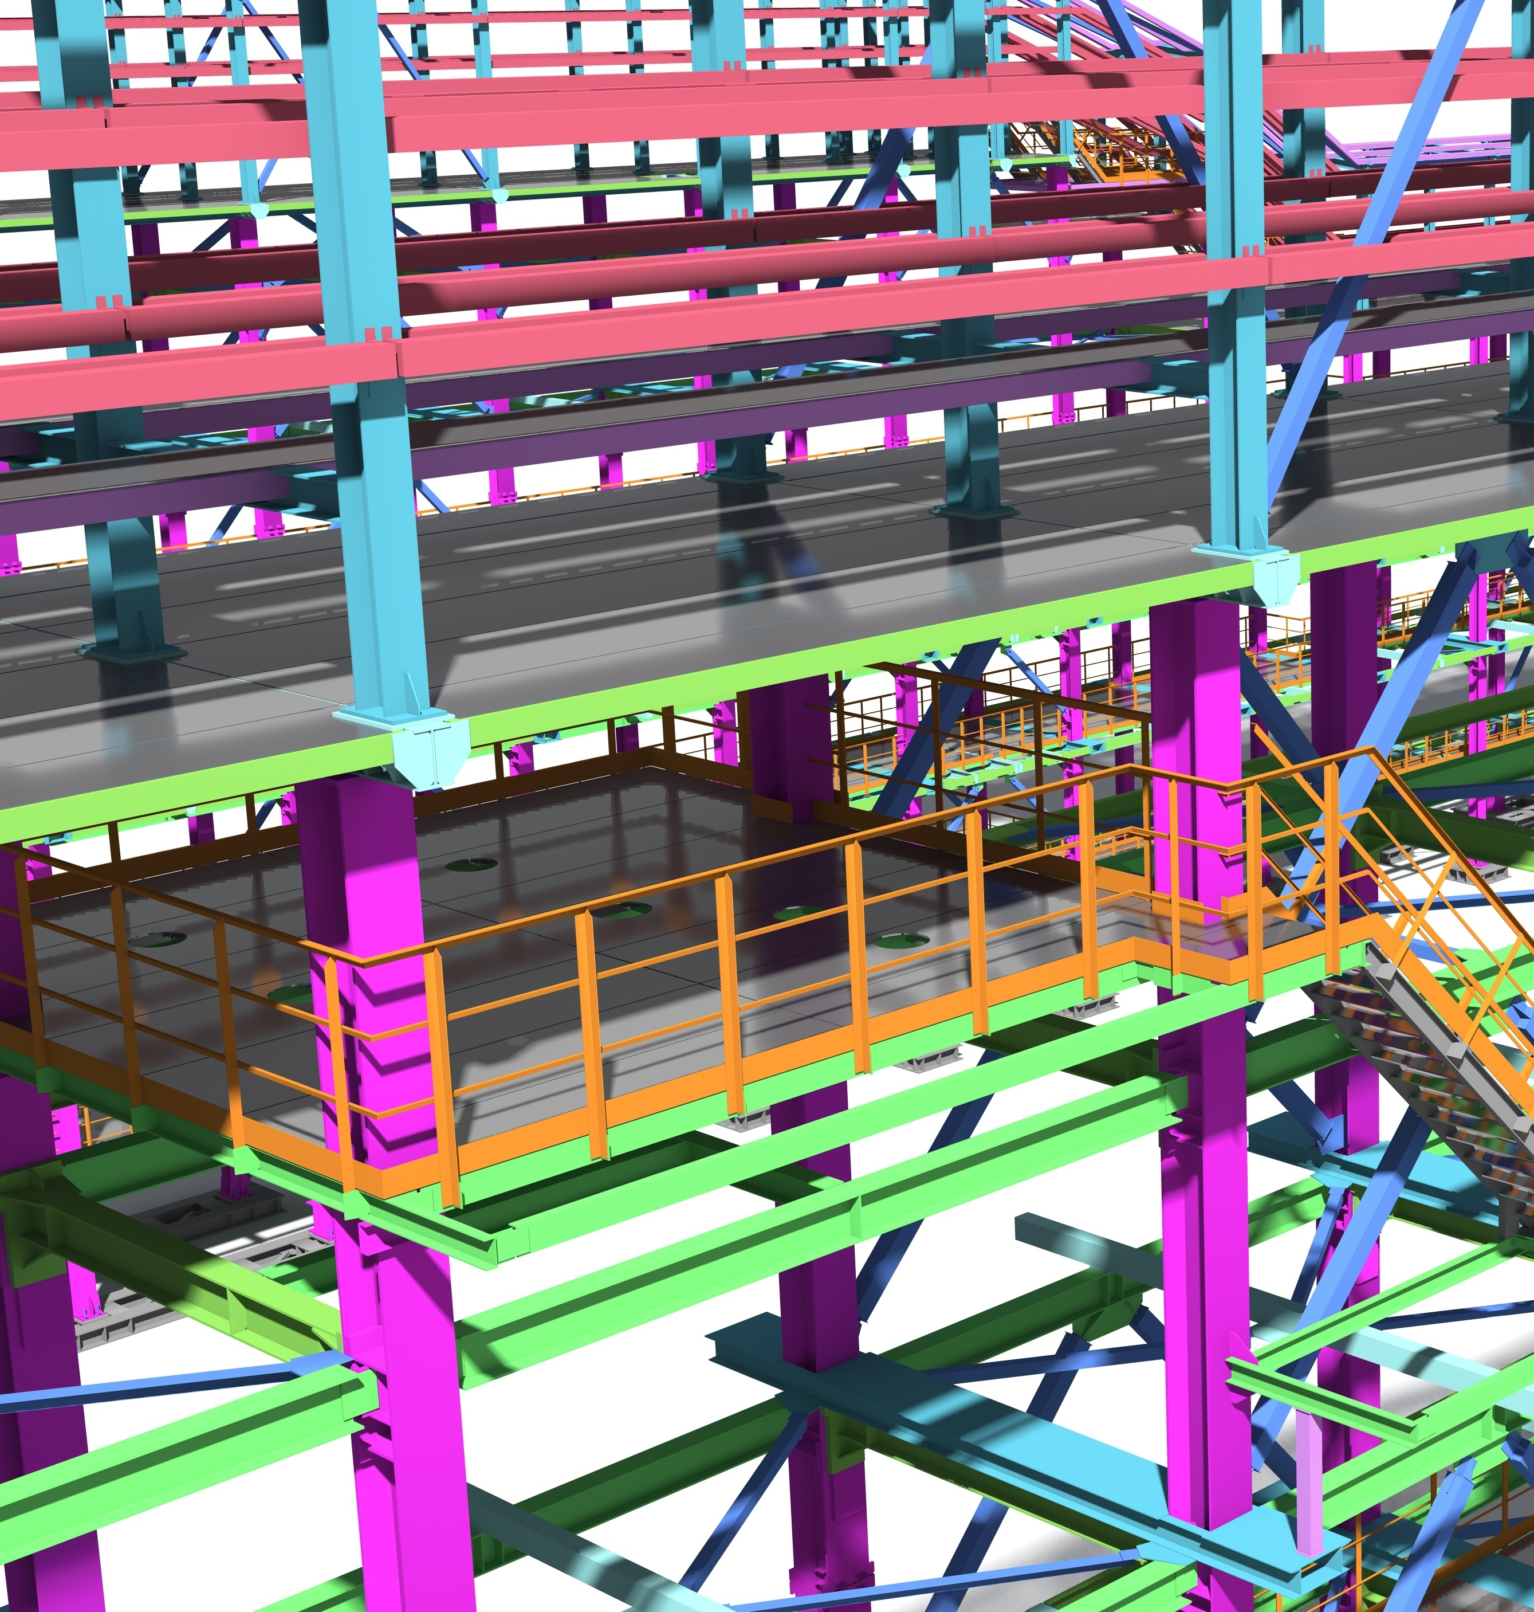
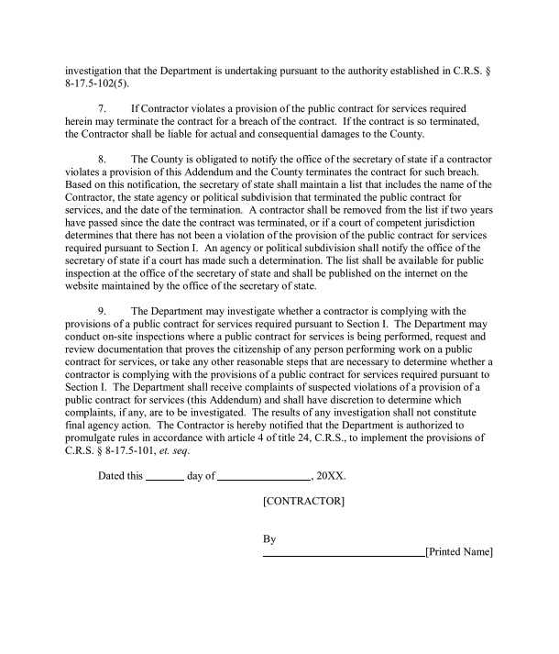

Egnyte Collaboration Capabilities
SECURE SHARING & CO-EDITING
MASSIVE FILE HANDLING
WORKFLOW AUTOMATION
Securely collaborate with external stakeholders.
Work with massively large files even over poor bandwidth.
Automate workflow and execute tasks without leaving Egnyte.

Slide 8
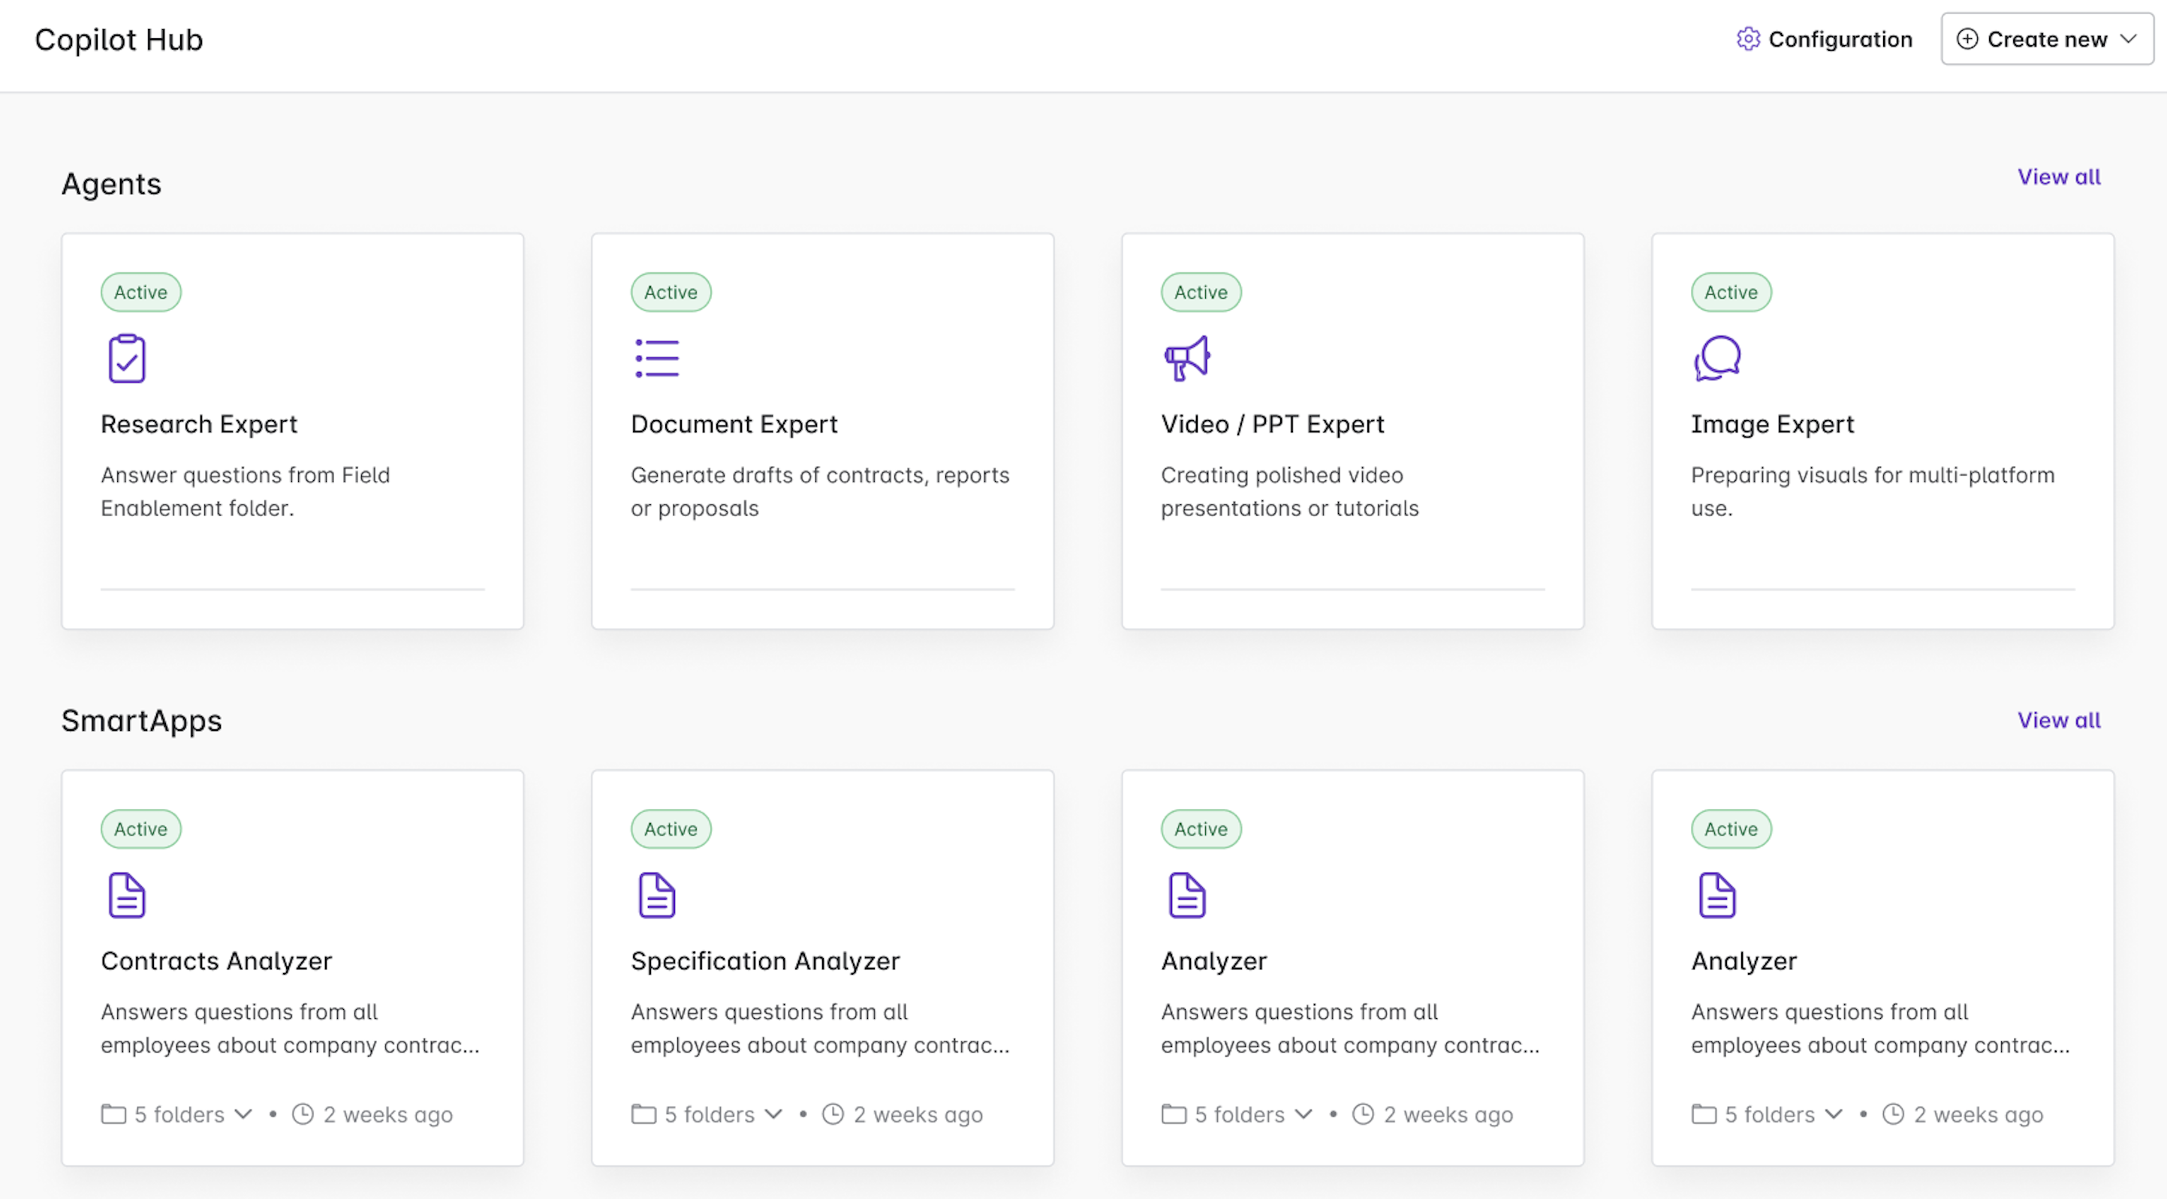
Egnyte Intelligence Capabilities
CONVERSATIONAL AI
AGENTS
AI SEARCH
Natural language interactions to gain insights from documents, images, A/V, and knowledge bases.
Automate complex tasks by securely leveraging your content, specialized skills, and ability to perform actions.
Use natural language to securely search for information and take advantage of AI-generated insights.
Notes:
Improve Agents description; all

Slide 9
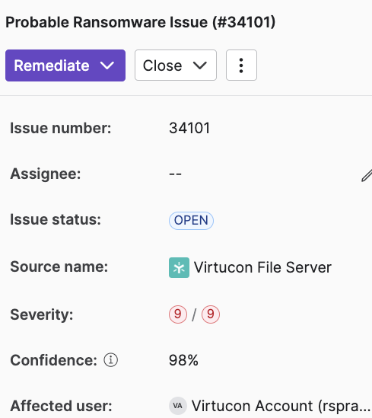
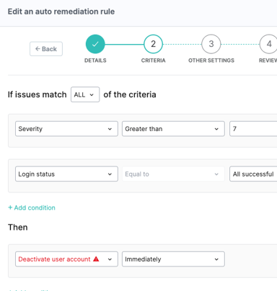
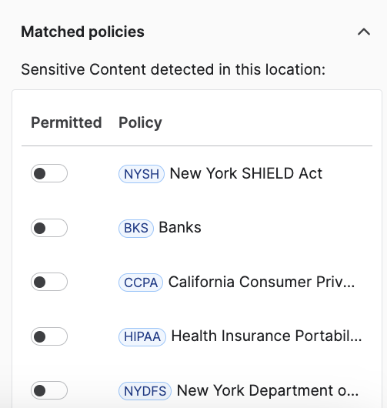

Egnyte Governance Capabilities
THREAT DETECTION
PREVENTIVE CONTROLS
POLICY-BASED GOVERNANCE
Detect and mitigate common security threats, such as unusual access to sensitive content.
Determine where your sensitive content resides and protect it from exposure.
Comply with cybersecurity and data privacy standards such as CMMC, HIPAA, ISO 27001, and the CPRA.
Notes:
- Detect and mitigate common security threats, such as unusual access to sensitive content. Here, the user's access to UK GDPR-protected content needs to be reviewed.
- Determine where your sensitive content resides and protect it from exposure. This company must protect content that's stored in more than 350,000 locations.

Slide 10

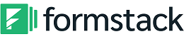

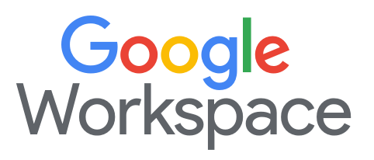







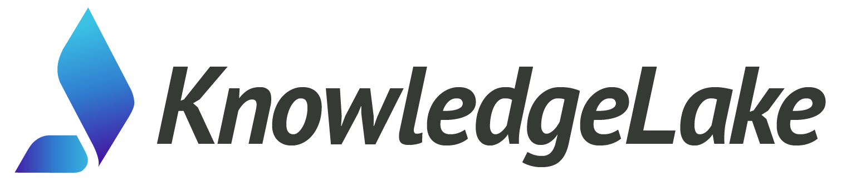
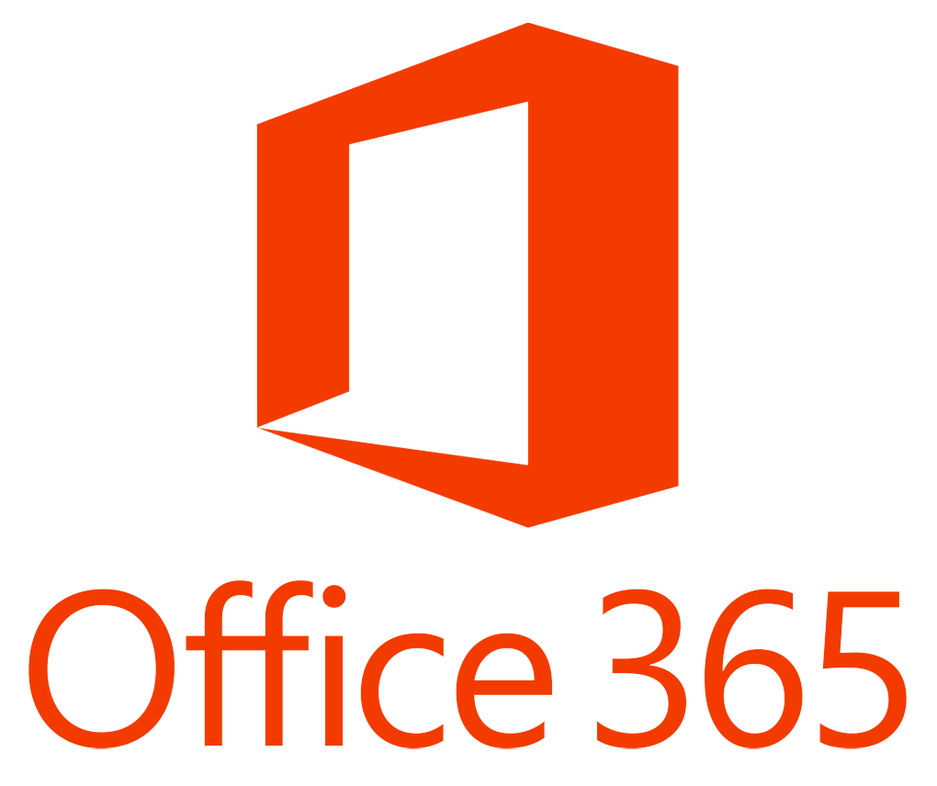









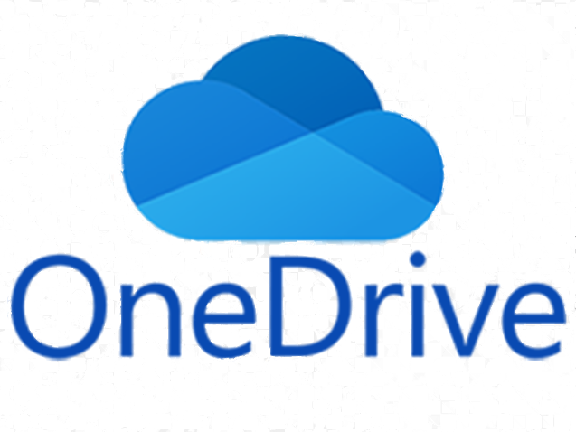












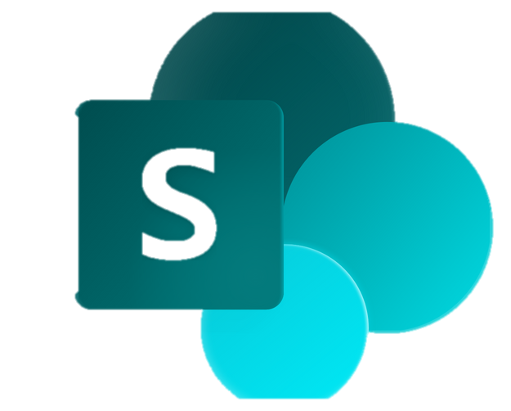






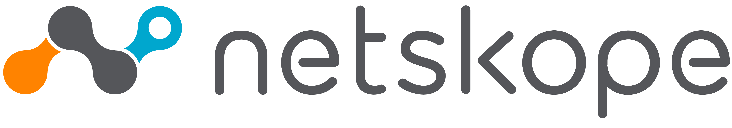












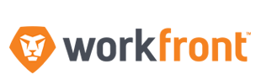

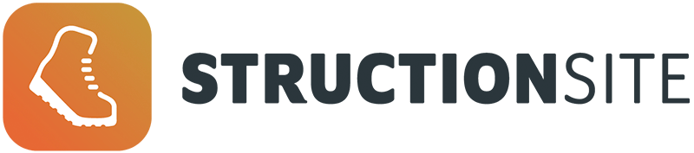
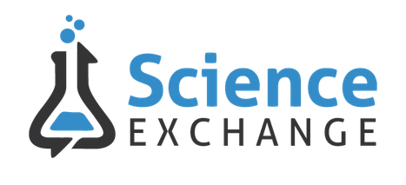


















Egnyte Integrations
CRM
PRODUCTIVITY
COLLABORATION
SECURITY
ANALYSIS & GOVERNANCE
TECHNOLOGY PARTNERS
INDUSTRY VERTICAL PARTNERS
AEC
MEDIA & ADVERTISING
LIFE SCIENCES
FINANCIAL SERVICES
LEGAL

Slide 11
CONTENT CLOUD
FOR MISSION-CRITICAL CONTENT
COLLABORATION
INTELLIGENCE
GOVERNANCE
Secure Sharing & Editing
Conversational AI
Threat Detection
Massive File Handling
Agents
Preventive Controls
Workflow Automation
AI Search
Policy-based Governance
Cloud-Distributed File Server
Edge Caching
Anomaly Detection
Flexible Permissions
Classification
Integrations
PLATFORM

Slide 12



AEC
FOOD & BEVERAGE
FINANCIAL SERVICES
Location: Washington, DC
Users: ~1,600
Content: ~290TB
Integrations: AutoCAD, Bluebeam, Revit, Procore
Location: Fuschl am See, Austria
Users: +15,000; 300 offices
Content: +750TB
Integrations: over 100
Location: Rosemont, IL
Users: ~5,100
Content: ~75TB
Integrations: MS, Splunk
Use cases:
External and internal project collaboration;
Data archiving & governance
Use cases:
Collaboration & co-editing;
Project archive;
Security & governance
Use cases:
Secure sharing;
Data governance and security policies;
Data ownership culture

Slide 13
Unified platform that combines:
A file-centric platform that gives your company full visibility and control over your data.
Seamless file sharing and co-editing while keeping all your data centralized in one location.
AI-powered insights tailored for accuracy, integrated into existing workflows, without having to move content in and out of Egnyte.
Comprehensive security, data privacy, and compliance capabilities that are integral to the Egnyte Content Cloud.
Notes:
SMEs

Slide 14



Egnyte Value
BOOST PRODUCTIVITY
IMPROVE DECISION-MAKING
MITIGATE RISK
Get More Done, Faster
Access, Share, and Co-edit
with all files in one place.
Make the Right Call
Private, Purposeful, and
Practical AI for your content.
Protect What Matters
Compliance, Security, and Control in one platform.
Notes:
Technology consolidation

Slide 15
Thank You!

Slide 16
Agenda
01 | Introductions
02 | Egnyte Focus
03 | Differentiated Capabilities
04 | Demo
05 | Next Steps
16

Slide 17

















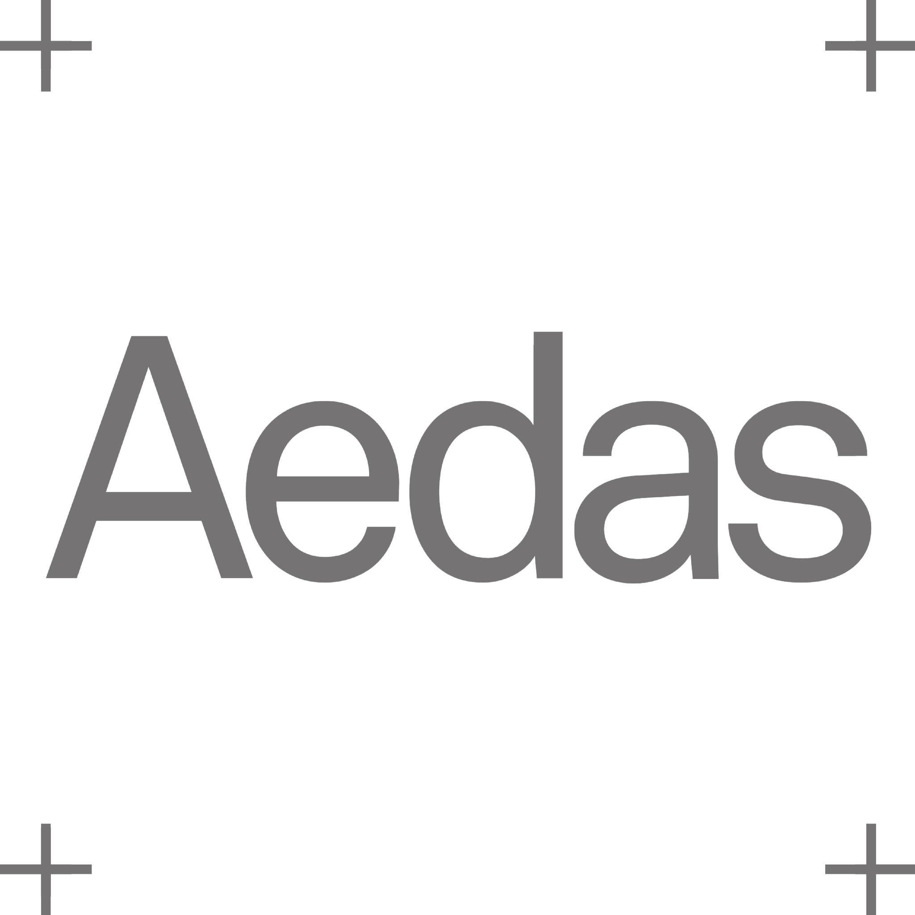











22,000+ Customers
4,000+ in AEC
Market leader in content collaboration, intelligence, and governance
Trusted by 22,000+ customers worldwide, from SMB to enterprise
Trusted by thousands of AEC customers worldwide
Vertical solutions for AEC, Financial Services, and Life Sciences
Founded in California in 2008
1,100+ employees - US, UK, Europe, India
Notes:
AEC-specific alternative for slide 2

Slide 18

22,000+ Customers
2,000+ in Financial Services
Market leader in content collaboration, intelligence, and governance
Trusted by 22,000+ customers worldwide, from SMB to enterprise
Trusted by 2,000+ Financial Services customers worldwide
Vertical solutions for Financial Services, AEC, and Life Sciences
Founded in California in 2008
1,100+ employees - US, UK, Europe, India
Notes:
Financial Services-specific alternative for slide 2

Slide 19

22,000+ Customers
600+ in Life Sciences
Market leader in content collaboration, intelligence, and governance
Trusted by 22,000+ customers worldwide, from SMB to enterprise
Trusted by 600+ Life Sciences customers worldwide
Vertical solutions for Life Sciences, AEC, and Financial Services
Founded in California in 2008
1,100+ employees - US, UK, Europe, India
Notes:
Life Sciences-specific alternative for slide 2

Slide 20



AEC
FINANCIAL SERVICES
LIFE SCIENCES
Subvertical: Engineering
Location: Central CA
Users: 200 users
Integrations: Civil 3D, Procore, Microsoft, GIS
Subvertical: Wealth Management
Location: Boston, MA
Users: 370 users
Integrations: Salesforce, M365 desktop
Subvertical: Biotech
Location: Redwood City, CA
Users: ~250 users
Integrations: M365 desktop, eTMF
Use cases:
Collaborating on complex CAD designs
GIS capabilities for mobile devices
Collaborating on content while in the field, often offline
Use cases:
Intuitive collaboration and file access from the desktop
Streamlined regulatory reporting and data governance
Stronger protection of sensitive financial data
Use cases:
Less than 1 day to deploy for external collaboration
Organize large volumes of real-time collaboration data
Security by controlling data access at a highly granular level
Notes:
Same slide as slide 12 but featuring smaller companies.

