Slide 1

PARTNER LOGO
Partner Website

Slide 2
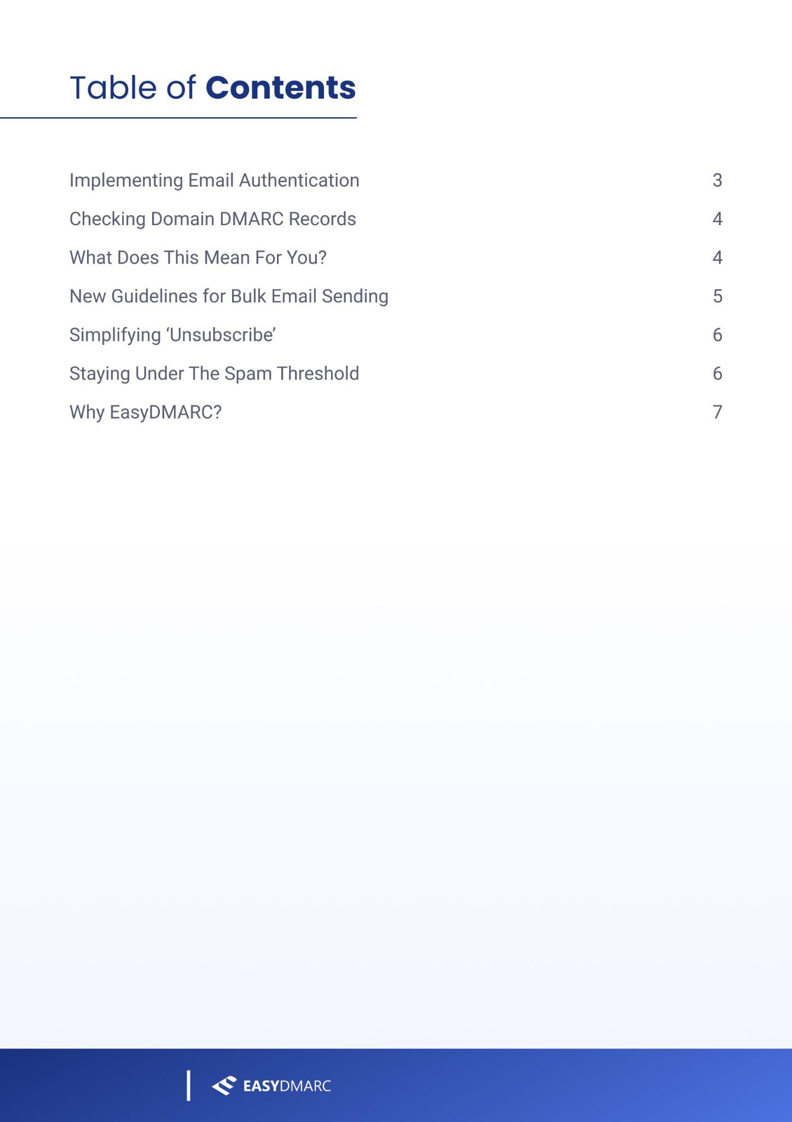
PARTNER LOGO
Partner website

Slide 3
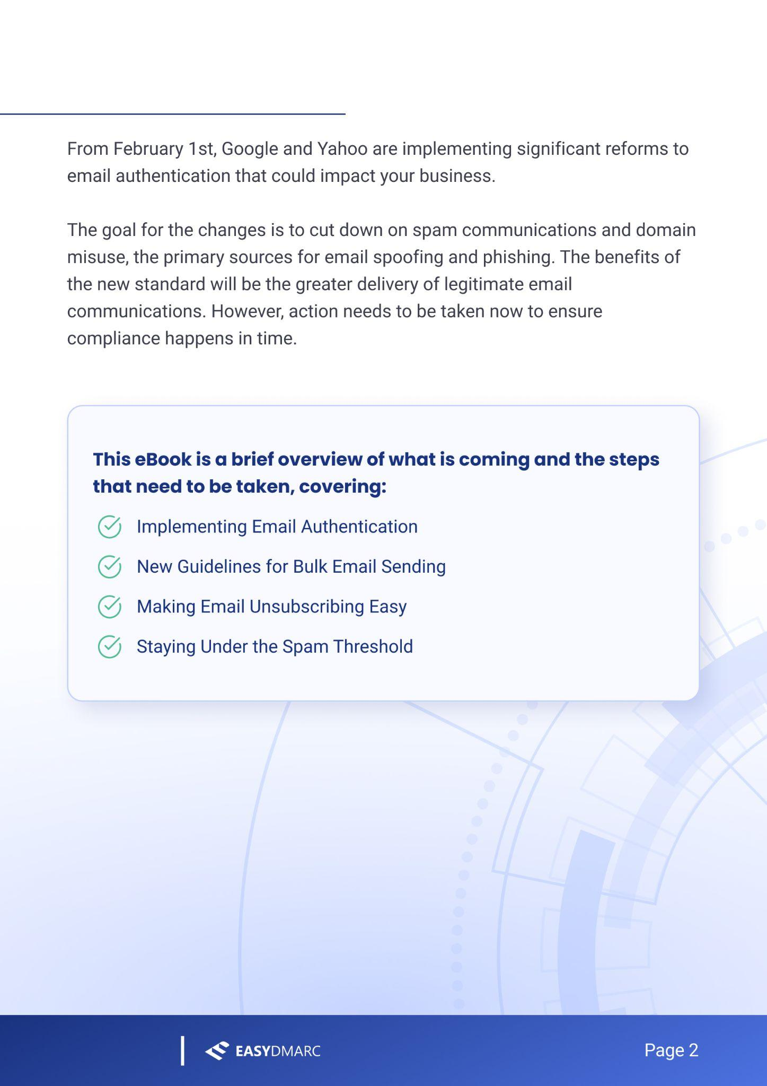
PARTNER LOGO
Partner website

Slide 4
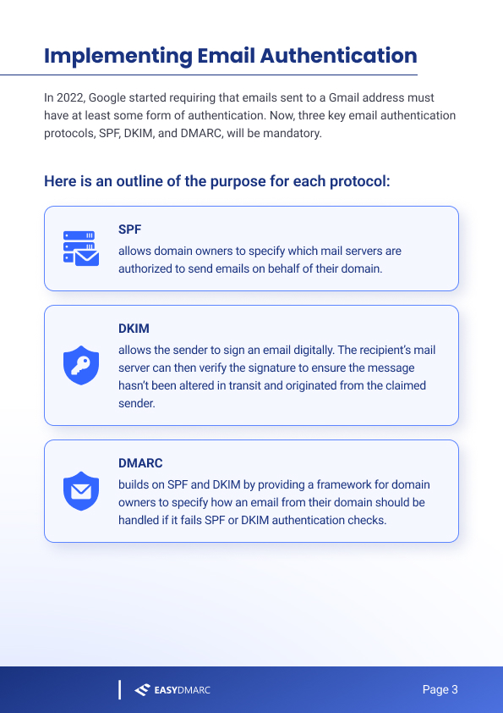
PARTNER LOGO
Partner website

Slide 5
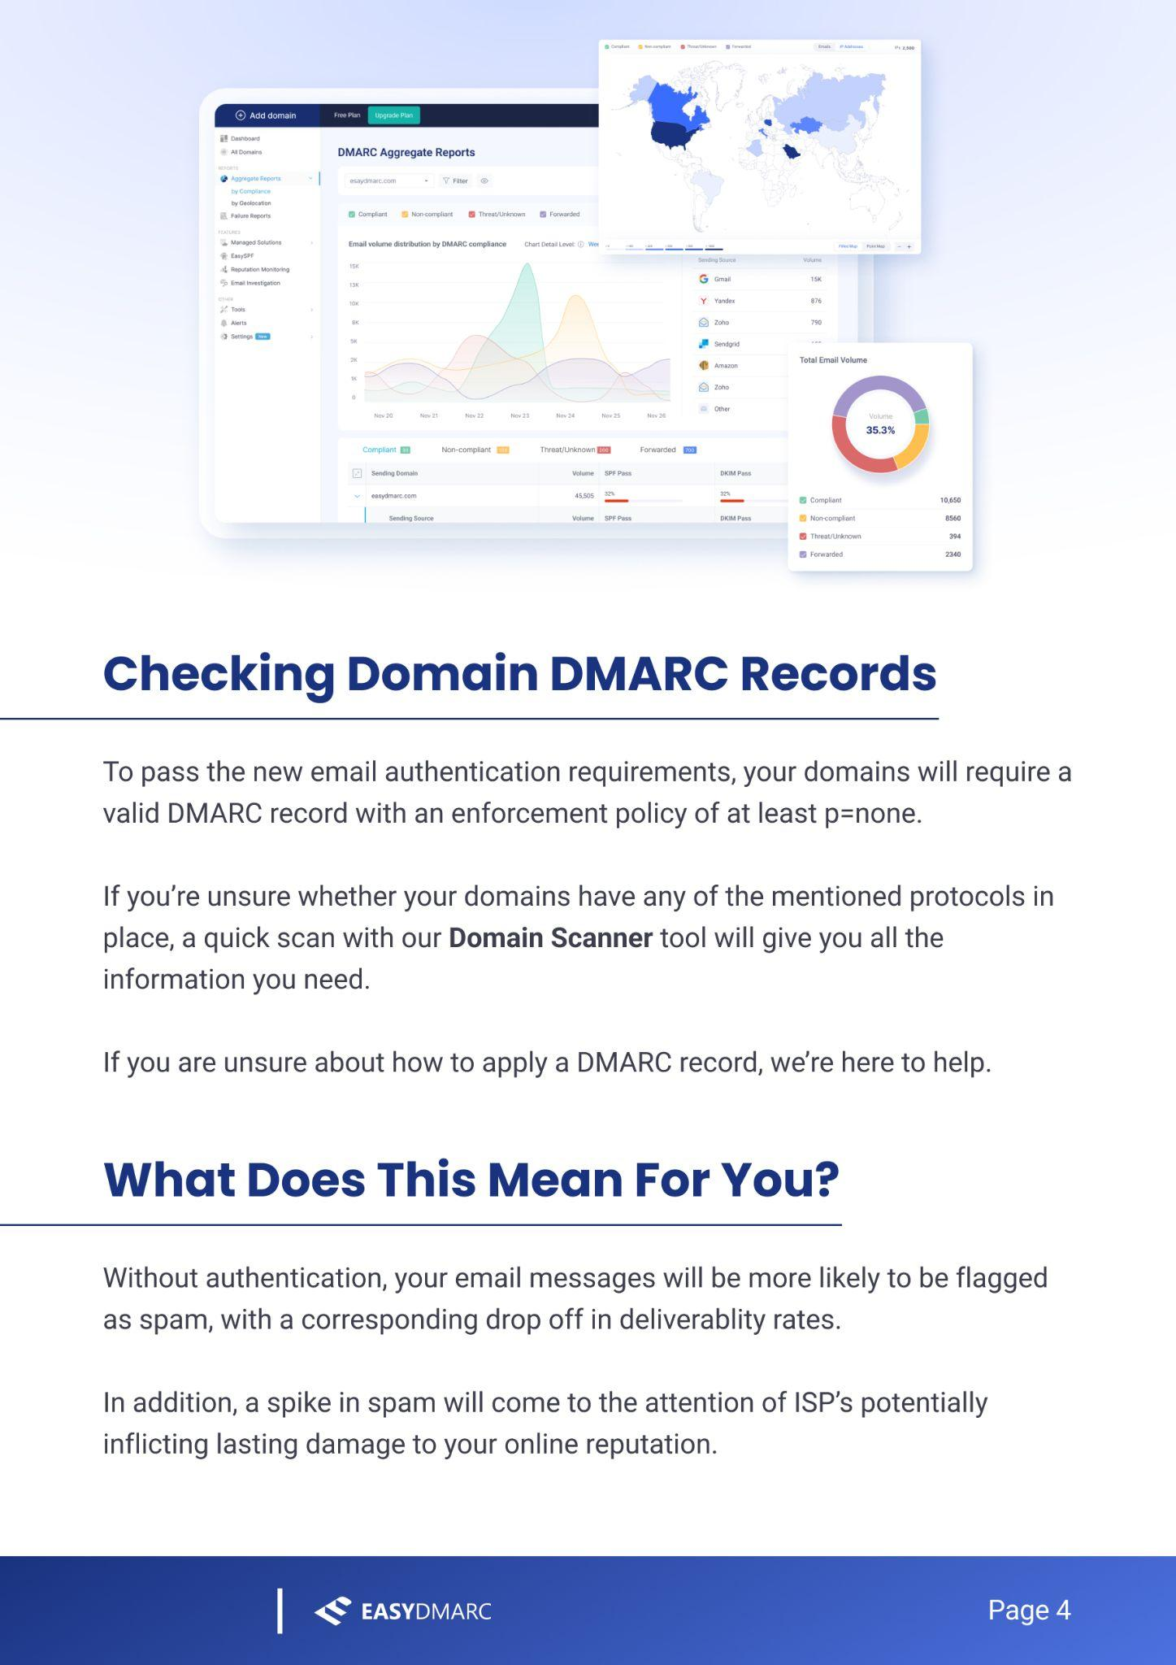
PARTNER LOGO
Partner website

Slide 6
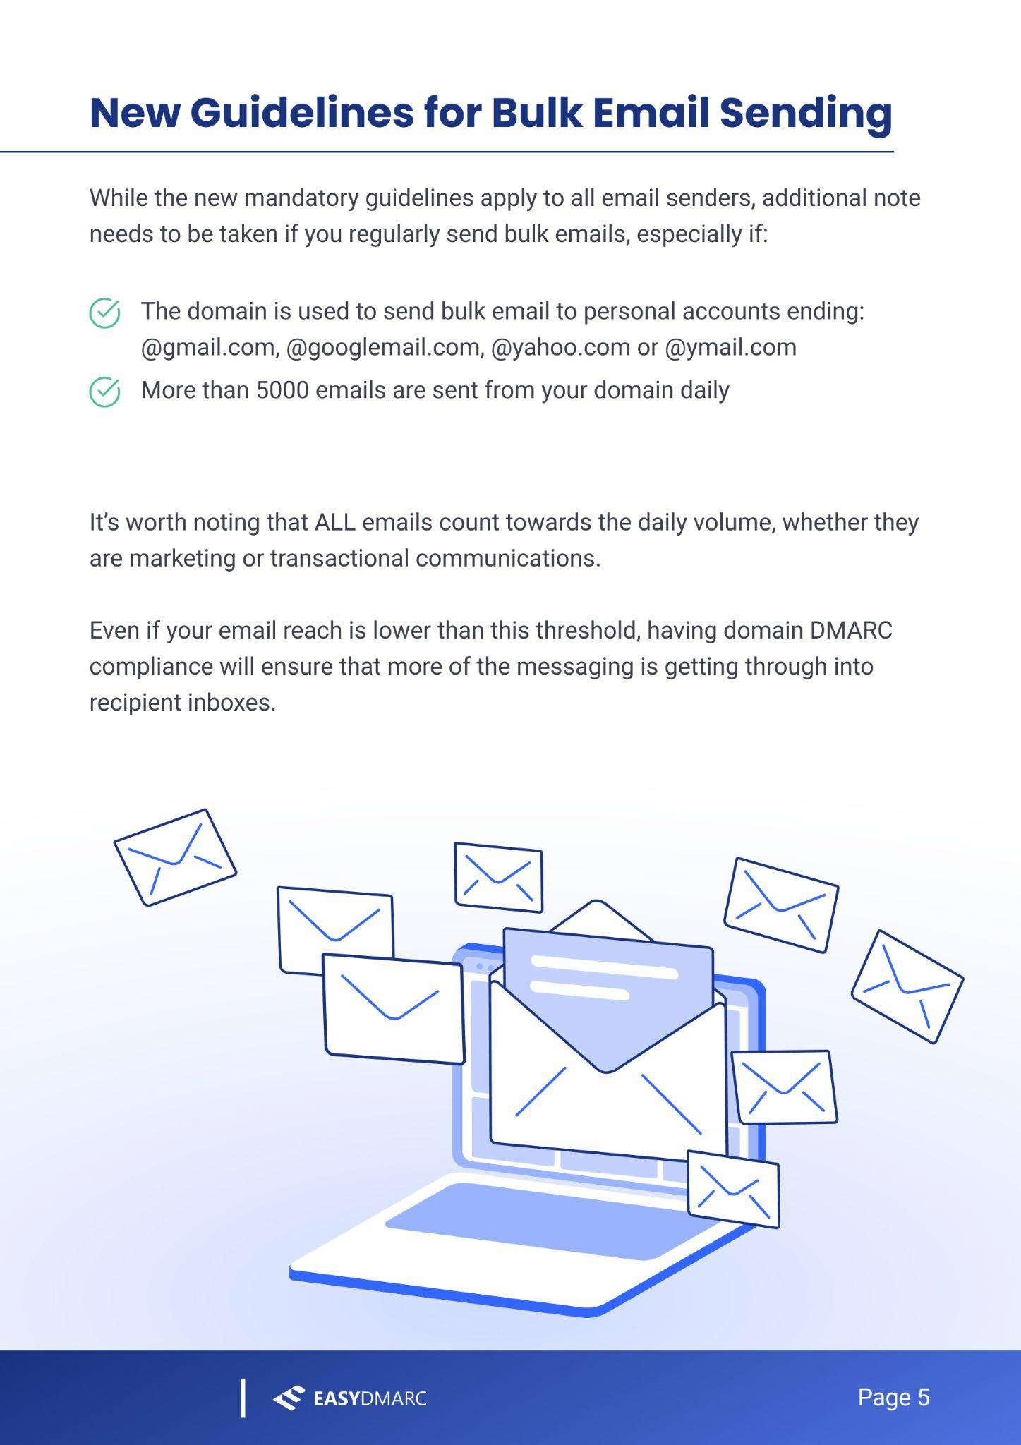
PARTNER LOGO
Partner website

Slide 7
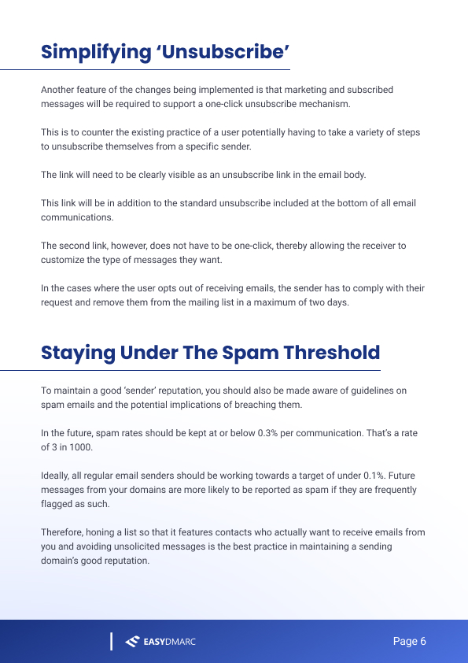
PARTNER LOGO
Partner website

Slide 8
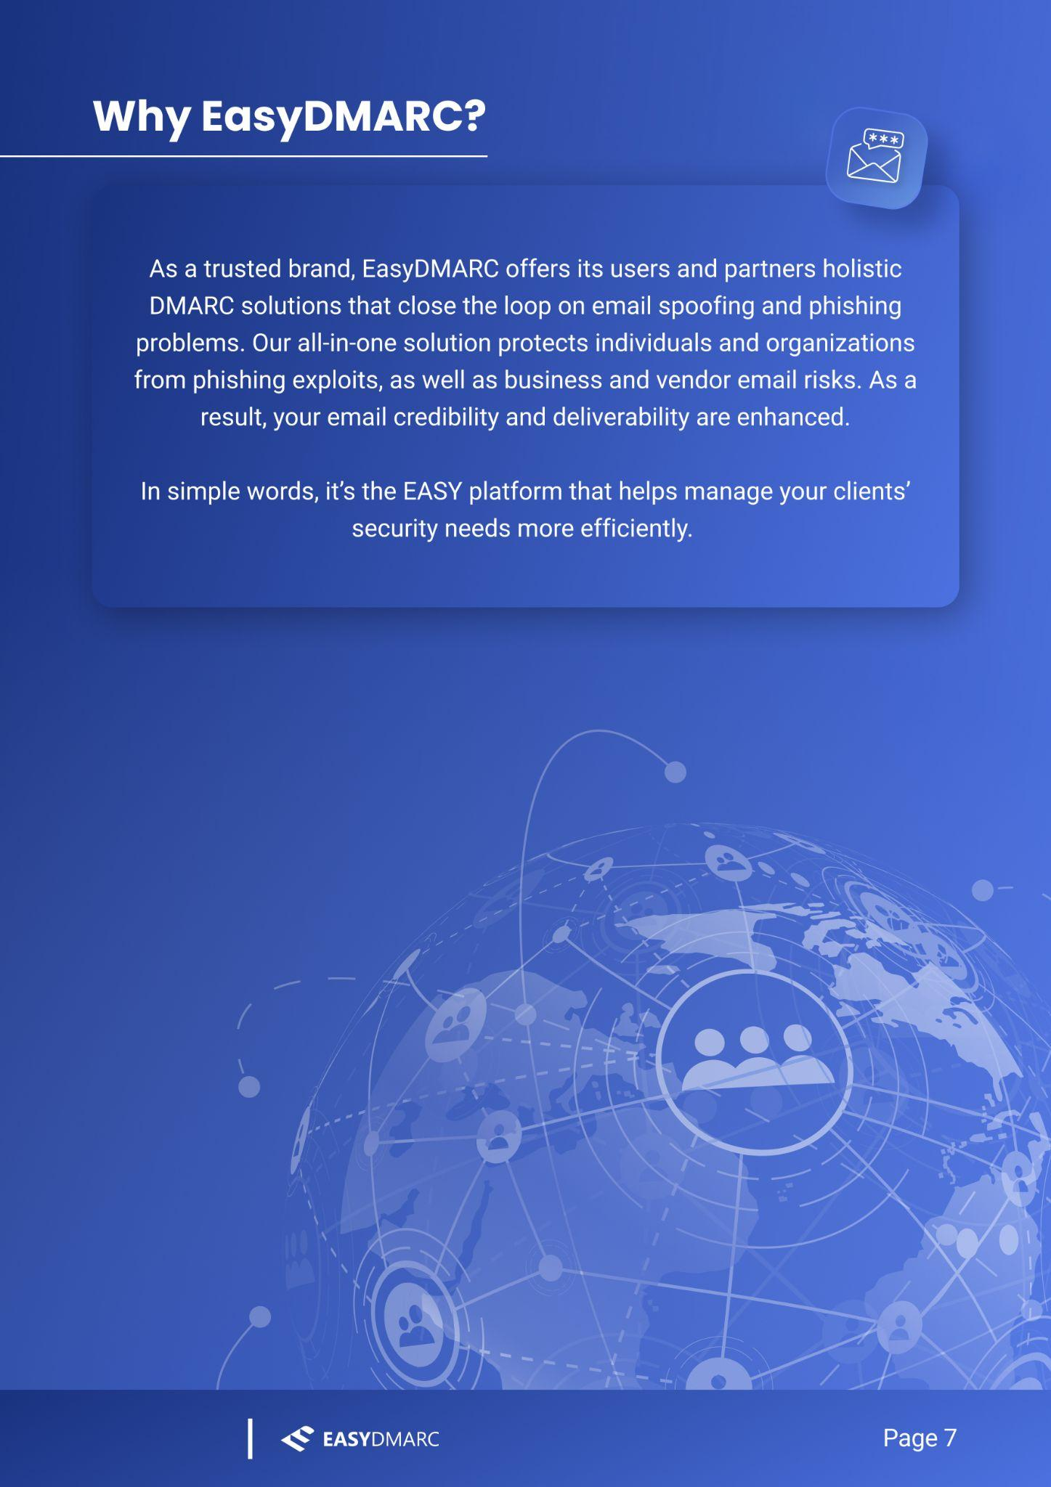
PARTNER LOGO
Partner website

Slide 9
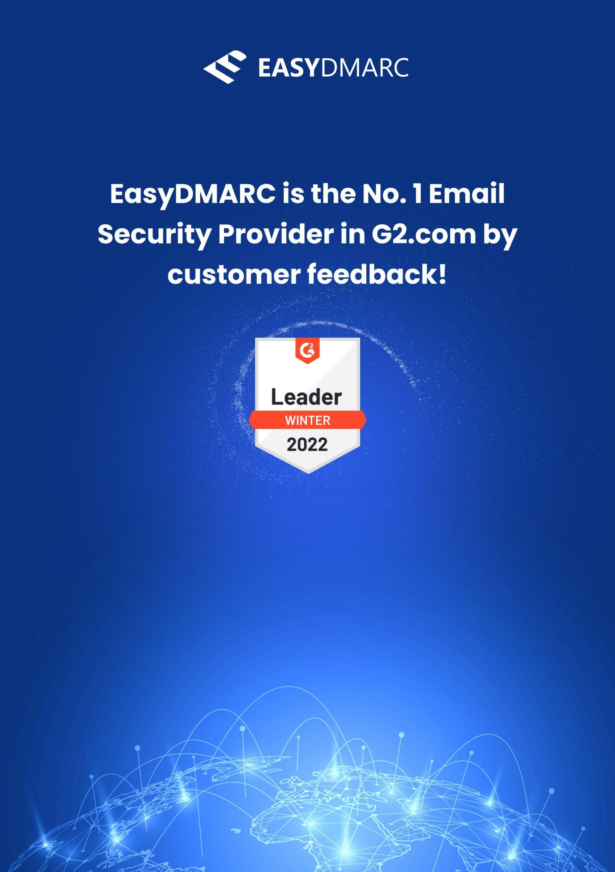



PARTNER LOGO
Email
Telephone
Website

